Slide 1
A Neural Oscillator for Position Controlled Joints
Independent Study + M.Sc Thesis Spot Talk
Sayantan Auddy
Advisor – Dr. Sven Magg

Slide 2

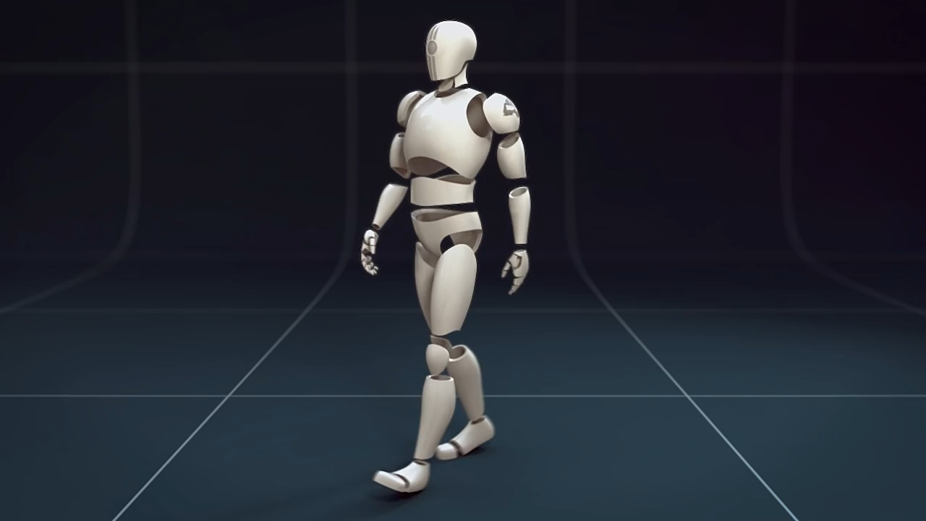
Motivation
The big picture
[https://youtu.be/_kzgk4Rnpqc]
[https://vimeo.com/59197431]
The specific problem
Torque controlled robot
Matsuoka oscillator
Torque output
Simulation
model
Notes:
To begin with, I would like to talk about two things.
First the big picture.
Advanced bipeds - bent knees and small careful steps.
Human-like gait - straight knees, and fast efficient steps.
Neural oscillators such as the Matsuoka oscillator can be used.
These can take advantage of the dynamics of the robot structure.
Circuits which generate rhythmic patterns that can be used to move joints
However, the Matsuoka oscillator generates torques and cannot be directly used on position controlled robots like the nao or the nico.
Hence its use was limited to custom made torque controlled robots only.
The specific problem of this study was to find a way so that the torque generating Matsuoka oscillator can be used on any position controlled robot.

Slide 3
Outline
Biological background
Matsuoka oscillator
Joint control using the Matsuoka oscillator
Coupled oscillators
Future work (master thesis spot talk)

Slide 4
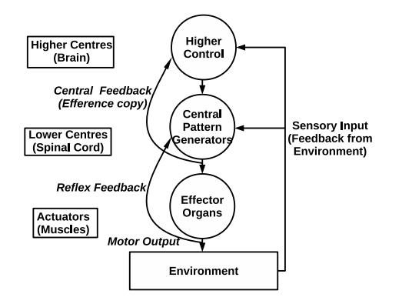
Biological Background
Neural Circuits (CPG) exist in the spinal cord
Rhythmic patterns produced without rhythmic input
Sensory feedback used for modulation
Neural components of motor systems
[Shepherd, 1994]
Notes:
Circuits in spinal cord
Rhythmic patterns

Slide 5
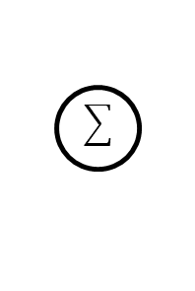
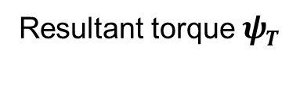
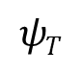
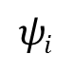
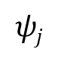
Half-center neuron model
Proposed by Brown to explain movements of a decerebrated cat
Self and mutual inhibition leads to switching of activity
[Brown, 1914]
CPG
$$ψi$$
t
i
Activation of i
Resultant torque $ψT$
Tonic input
+
D
$$ψT$$
t
-
Tonic input
j
Activation of j
$$ψj$$
t
Driving neuron pool
Interneuron pool
Inhibitory connection
Excitatory connection

Slide 6
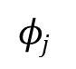
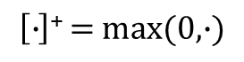

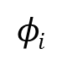
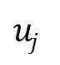
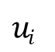


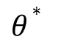

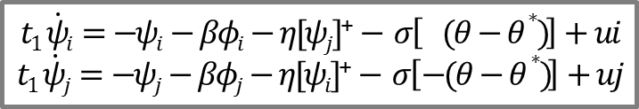
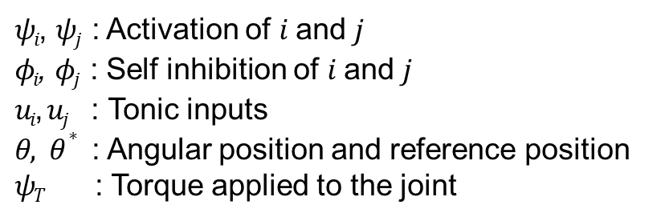
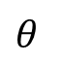

Matsuoka Oscillator
Mathematical model of neural rhythm generators
Based on a piece-wise linear set differential equations
[Matsuoka, 1985, 1987]
[Ronsse, 2009]
Matsuoka equations
Feedback
$$φi$$
Proprioceptive
feedback
$$t1 \dot{ψi}=−ψi−βφi−η[ψj]\text{+}− σ\left[ (θ−θ∗ )\right]+ui$$
$$t1 \dot{ψj}=−ψj−βφj−η[ψi]\text{+}− σ\left[−(θ−θ∗ )\right]+uj$$
$$ui$$
$$ψi$$
D
$t2 \dot{φi}=−φi+[ψi]$⁺
$t2 \dot{φj}=−φj+[ψj]$⁺
$$uj$$
$$θ$$
$$ψj$$
$$φj$$
$θ∗$
$$ψT=hψ([ψi]\text{+}−[ψj]\text{+})$$
$$\left[∙\right]\text{+}=max(0,∙)$$
Simple inertial system
$ψi$, $ψj$ : Activation of $i$ and $j$
$φi$, $φj$ : Self inhibition of $i$ and $j$
$ui$, $uj$ : Tonic inputs
$θ, θ∗$ : Angular position and reference position
$ψT$ : Torque applied to the joint
$$I\ddot{Θ}=ψT−γ\dot{Θ}$$
$$⇒I\ddot{Θ}+γ\dot{Θ}−ψT=0$$
[Ronsse, 2009]
Notes:
Feedback is in terms of angle, not torque
After torque equation – torque controlled robots only

Slide 7
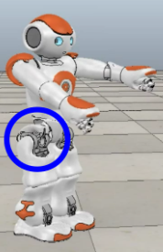
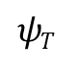
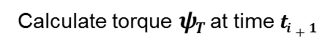

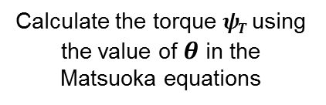
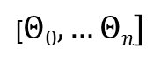
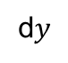
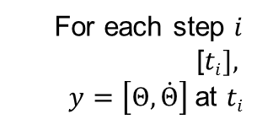
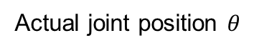
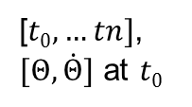
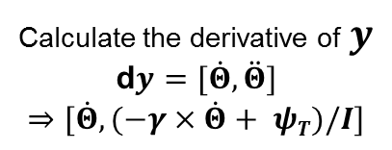

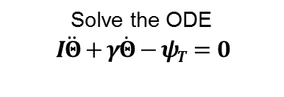

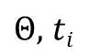
Proposed Joint Control Technique
Initialization
Mechanical Inertial System
Initialize the joint
For each step $i$
[$ti],$
$y=\left[Θ, \dot{Θ}\right]$at $ti$
Set parameters $I, γ$
Set oscillator parameters
[$t0,…tn]$,
$[Θ, \dot{Θ}]$ at $t0$
Calculate torque $ψT$ at time $ti+1$
Set time steps
Calculate the derivative of $y$
d$y=[\dot{Θ}, \ddot{Θ}]$
$$⇒[\dot{Θ}, (−γ×\dot{Θ}+ ψT)/I]$$
Solve the ODE
$$I\ddot{Θ}+γ\dot{Θ}−ψT=0$$
1
ODE
solver
2
8
7
[$Θ0,…Θn]$
d$y$
3
Robot Joint
2-7
6
$$ψT$$
$Θ,$ $ti$
Target angle $Θ$
Matsuoka Torque
4
Set joint to angle $Θ$
Calculate the torque $ψT$ using the value of $θ$ in the Matsuoka equations
5
Actual joint position $θ$

Slide 8
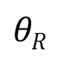
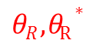

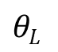
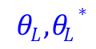
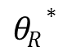
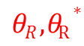
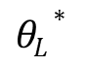
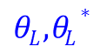

Coupling of oscillators
$θR , θR∗$
i
$θL , θL∗$
D
$$\text{j}$$
$$θL$$
Coupling at the level of output variables
$$θL∗$$
$$θR∗$$
j
$$θR$$
D
$$i$$
$θR , θR∗$
$θL , θL∗$
[Ronsse, 2009]

Slide 9
Anti-phase / in-phase oscillations
Anti-phase
In-phase

Slide 10
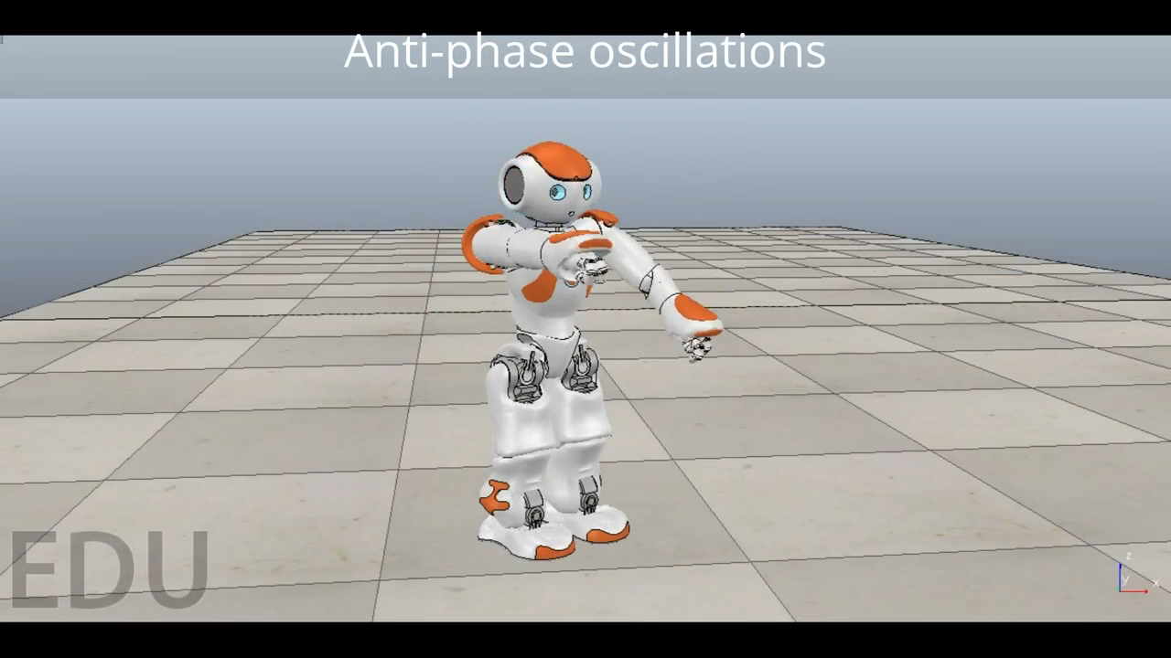
Joint Control Demonstration

Slide 11
Conclusion
Neural oscillators – bio-inspired joint control
Matsuoka oscillator was limited to torque controlled robots
Presented joint control technique adapts Matsuoka oscillator to position controlled robots
Can serve as a base for a framework of biped locomotion

Slide 12
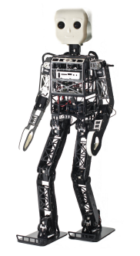
Future Work
Development of a bio-inspired framework for walking
Can be implemented on any position controlled robot
Uses Matsuoka oscillators for controlling joints
Balance maintained using a neural network based controller
Notes:
Network of oscillators to control leg and hip joints
Oscillator connections, number of parameters, symmetry
Find optimum parameters for oscillators for walking without feedback from vestibular sensors:
on a level surface
on an upward or downward slope
transitioning from a flat to a sloping surface
Balance control using vestibular sensors

Slide 13
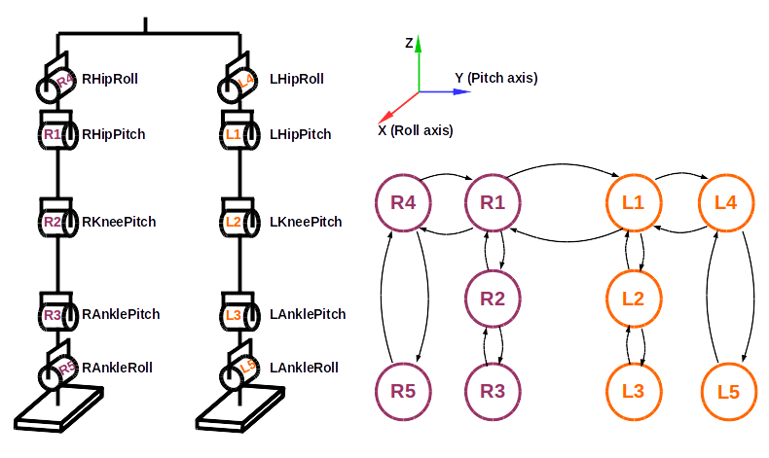
Neural oscillator network
R4
R1
L1
L4
R2
L2
R5
R3
L3
L5
Neural oscillator network controlling joints for walking
+
Adapted from [Kieboom, 2009]
PSO
Optimization of oscillator parameters using PSO variants (high dimensional problem spaces)
[Pant, 2007]
Notes:
Each oscillator has multiple parameters
Around 70 to 80 parameters in total

Slide 14
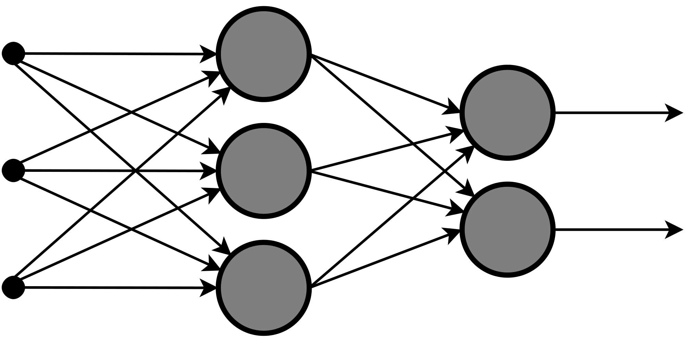
Balance Controller
Neural oscillator network
Walking speed/direction
R4
R1
L1
L4
Balance controller
Parameter adjustment
R2
L2
R5
R3
L3
L5
Target angles
Proprioceptive feedback
Filtered vestibular information
State Estimation
Vestibular information
Adapted from [Missura, 2015]
Biped robot

Slide 15
Literature
[Brown, 1914] T G Brown. On the nature of the fundamental activity of the nervous centres. The Journal of Physiology, 1914.
[Kieboom, 2009] J V D Kieboom. Biped Locomotion and Stability - A Practical Approach. Master’s thesis, University of Groningen, 2009.
[Matsuoka, 1985] K Matsuoka. Sustained oscillations generated by mutually inhibiting neurons with adaptation. Biological cybernetics, 1985.
[Matsuoka, 1987] K Matsuoka. Mechanisms of frequency and pattern control in the neural rhythm generators. Biological Cybernetics, 1987.
[Missura, 2015] M Missura and S Behnke. Gradient-driven online learning of bipedal push recovery. IROS, 2015.
[Pant, 2007] M Pant, T Radha, and V P Singh. A Simple Diversity Guided Particle Swarm Optimization. In IEEE Congress on Evolutionary Computation, 2007.
[Ronsse, 2009] R Ronsse, D Sternad, and P Lefevre. A computational model for rhythmic and discrete movements in uni-and bimanual coordination. Neural computation, 2009.
[Shepherd, 1994] Gordon M. Shepherd. Neurobiology. Oxford University Press, 1994.

Slide 16
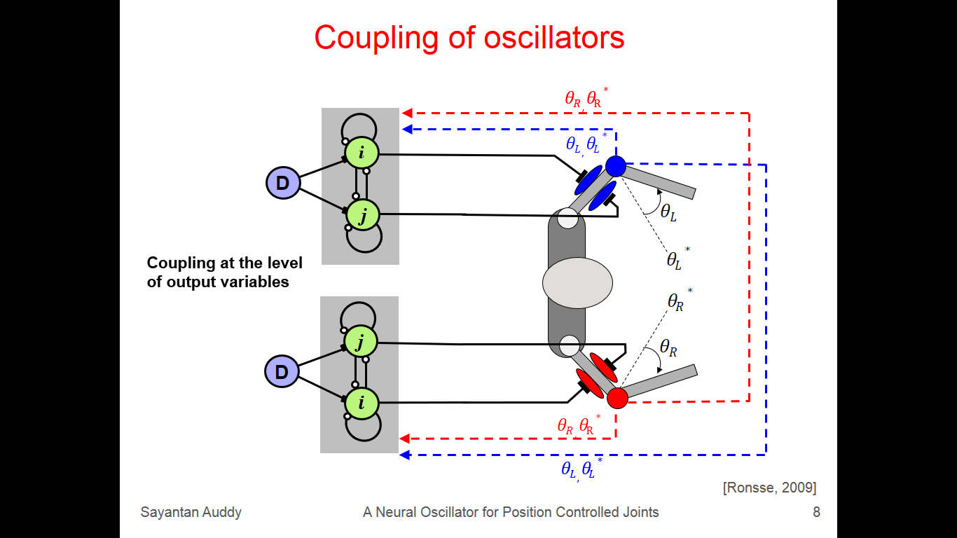
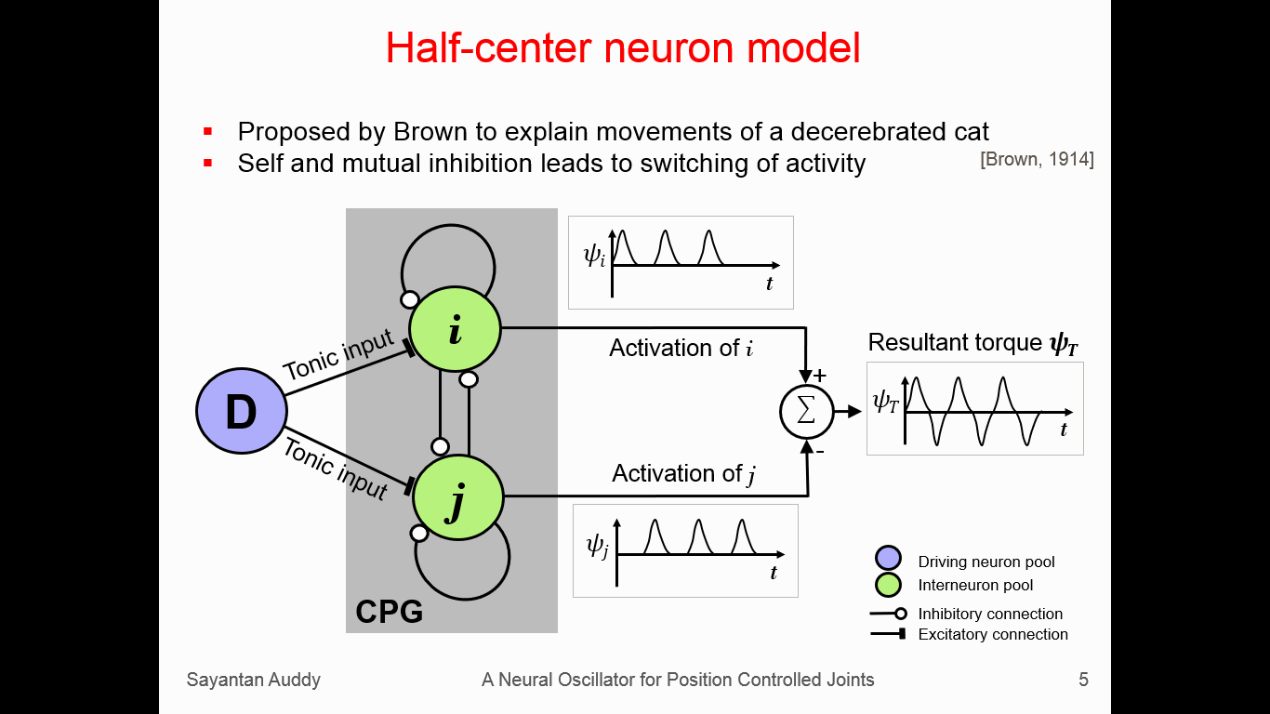
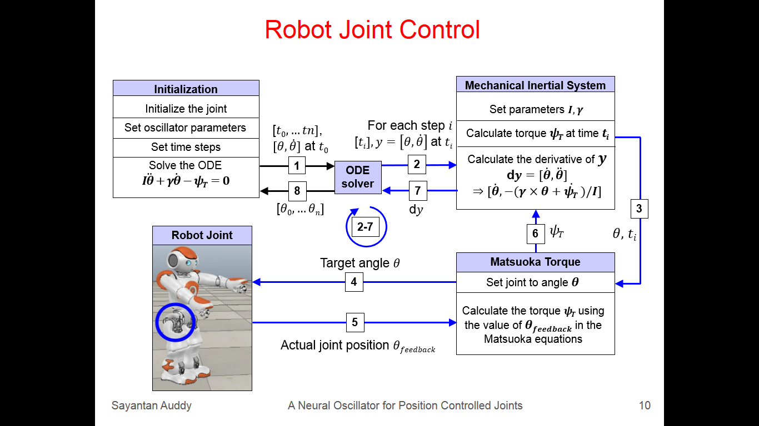
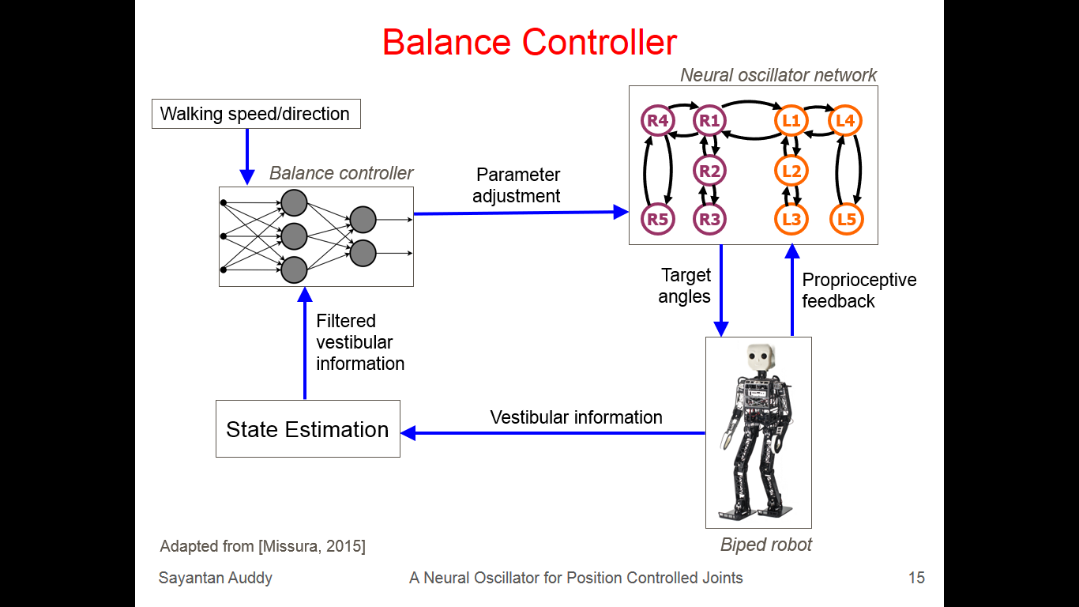
Thank you
Notes:
Slides 5, 8, 10, 15

Slide 17
Extra slides

Slide 18


Different Coupling Mechanisms
$θR , θR∗$
i
E
$θL , θL∗$
D
$$\text{j}$$
F
$$θL$$
Coupling at the level of internal state variables
$$θL∗$$
Coupling at the level of output variables
Coupling at the input level
$ψLi$, $ψLj$
$ψRi$, $ψRj$
$$θR∗$$
j
F
$$θR$$
D
$$i$$
E
$θR , θR∗$
$θL , θL∗$
[Ronsse, 2009]

Slide 19


Output Pattern Modulation
Joint torques
Joint angles
-- joint angle
-- reference position
Reference angle $θ^{∗}$ varied
(0 to 1 to -1 radians)
Tonic inputs $u_{i},u_{j }$varied from 1.0 to 4.0
Notes:
Replace with properties useful for walking slide?

Slide 20

Helpful Properties
Stable limit cycle properties
Entrainment
Easy to modulate waveforms
Any number of oscillators can be coupled together
Joint angles
-- joint angle
-- reference position
Reference angle $θ^{∗}$ varied
(0 to 1 to -1 radians)
Notes:
Replace with properties useful for walking slide?

Slide 21
Stable Attractors
Difference of activation (s)
Final phase difference (rad)
Time period of oscillation (s)

